Slide 1
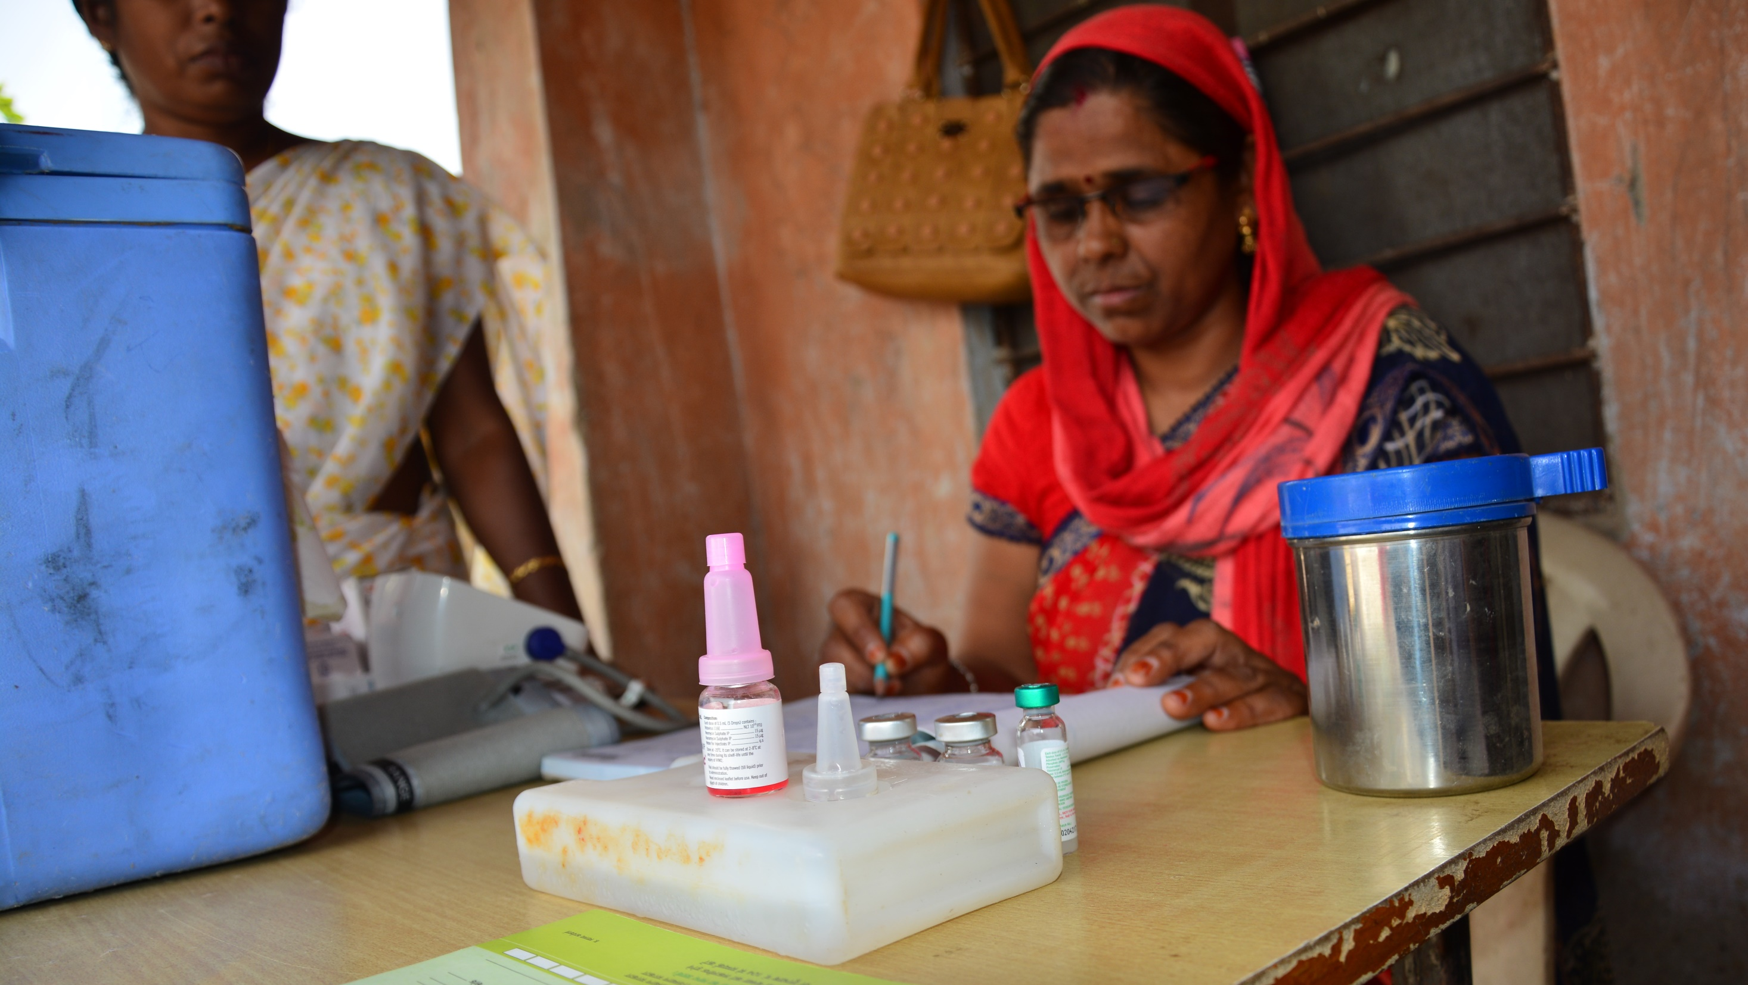

Anaphylaxis kit

Slide 2
Anaphylaxis kit
Should be available at all immunization sessions.
Contents of Anaphylaxis kit-
1 mL ampoule of adrenaline (1:1000 aqueous solution) – 3 nos.
1 mL syringes or 40 unit syringes– 3 nos.
24G/25G needles (1 inch) - 3 nos.
Swabs – 3 nos.
Job aid – Annexure 1 of the Operational Guidelines
Format for certification of anaphylaxis kit by medical officer with contact details

Slide 3
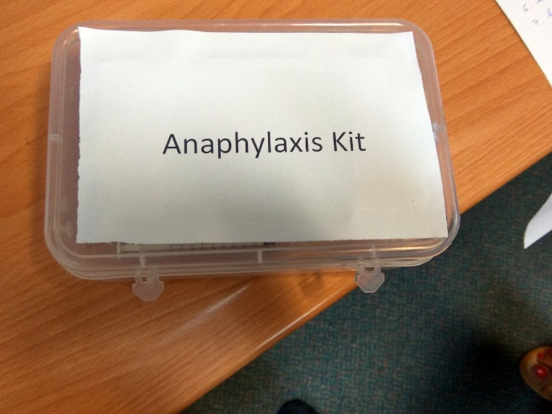
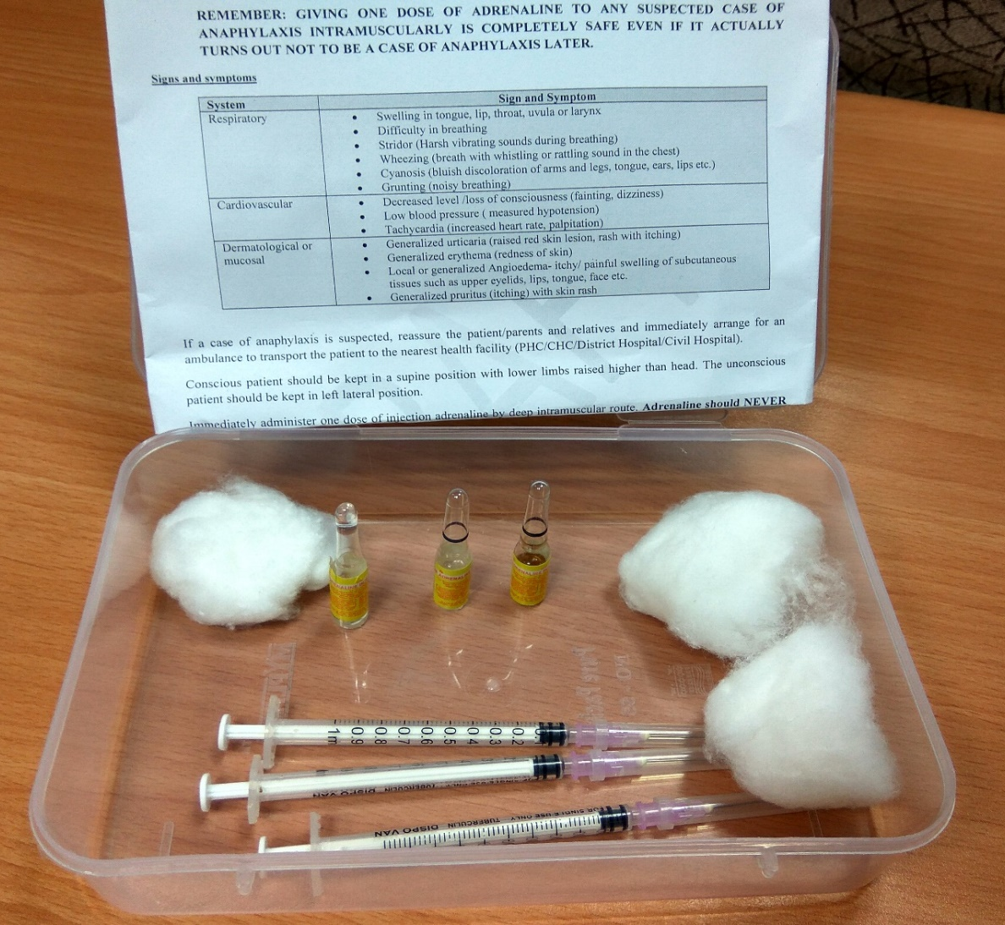
Anaphylaxis kit for ANM

Slide 4
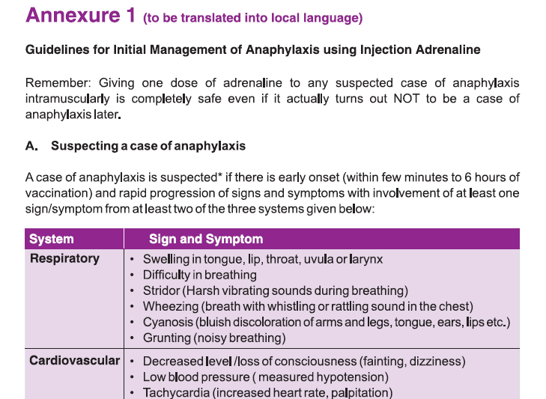
Job aid in Anaphylaxis kit
Annexure 1 to be translated in local language & be placed in each Anaphylaxis kit

Slide 5
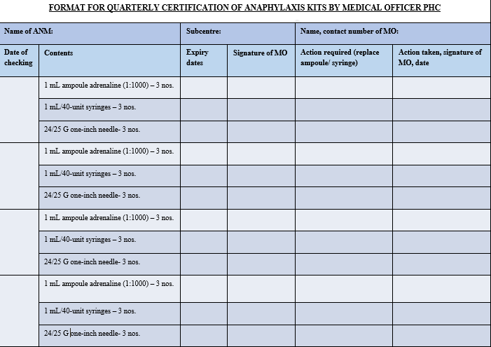
Certification
Once in three months (quarterly)
Medical officer will check contents of anaphylaxis kits
Ensure insulin/tuberculin syringes supplied do not have fixed needles
Specifically check expiry dates of all adrenaline vials to ensure expiry is not within next three months
If expiry is within next three months, ensure replacement of adrenaline vials with expiry beyond three months
Anaphylaxis kit is to be quarterly certified by the medical officer in the format

Slide 6
Logistics management
Each ANM will be provided one anaphylaxis kit
MO PHC should ensure that adequate buffer stock of adrenaline injection (10% of the requirement for total number of ANMs under the PHC) is available at PHC.
At the district, buffer stock of adrenaline ampoules equivalent to 20% of annual requirement of the district should be maintained.

Slide 7
Anaphylaxis kit and AEFI kit
Anaphylaxis kit | AEFI kit
At immunization session site | At health facility well equipped to manage anaphylaxis (PHC/CHC, Sub-centre etc.)
For use by ANM | For use by medical officer
Contains adrenaline, tuberculin/insulin syringes, 24/25 G one inch needles, swabs, guidelines/job aid with dose calculation, certification format | In addition to contents of the Anaphylaxis kit, contains intubation and resuscitation equipment, hydrocortisone (injection and tablet), Ringer lactate, Normal saline, 5 % dextrose, IV drip set, scalp vein sets etc.

Slide 8
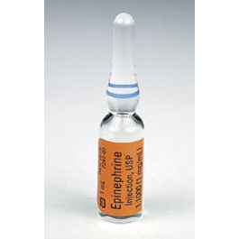
Precautions
Short expiry of Adrenaline (12 to 18 months from date of manufacturing)
To be stored in airtight containers, protected from light.
Dosage: 0.01ml/Kg body weight (refer to age appropriate dosing chart)
Age group (in years) | Dose for single administration in ml (tuberculin) or units (insulin)
0-1 | 0.05 ml / 2 units
1-6 | 0.1 ml / 4 units
6-12 | 0.2 ml / 8 units
12-18 | 0.3 ml / 12 units
Adults | 0.5 ml / 20 units

Slide 9
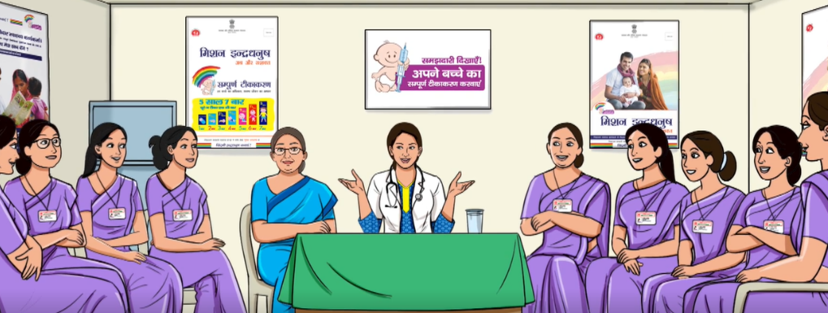
Operationalization and roll out of Adrenaline trainings

Slide 10
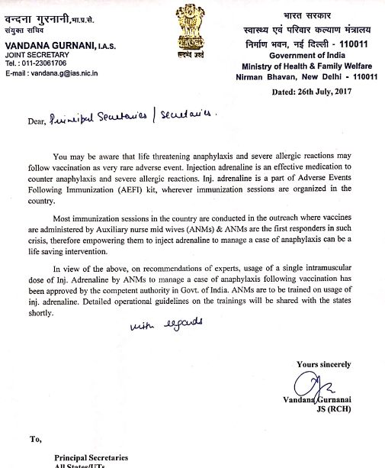
State level activities
Notification/ letter will be issued from state for operationalization of Adrenaline guideline.
Ensure completion of health worker trainings within 6 months of issue of notification/letter.
Roll out of cascade trainings -
At State level- All RCHOs/District training teams
Necessary guidance to authorize ANM to hire vehicle for transporting the patient to nearest PHC/CHC, in case of non availability of ambulance

Slide 11
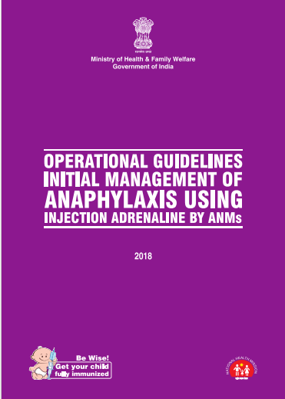
State level activities
Translation/printing of training material in vernacular language (Annexure 1, pre & post training test formats, Annexure 3) at least one per ANM and facilitator.
Translation of adrenaline film into local language
Trainings are to be conducted for roll out of adrenaline use for management of anaphylaxis by using Part C (training head) of PiP.
Trainings at all level are to be well documented and monitored for quality.

Slide 12

At district level
Roll out of cascade trainings -
At District level- PHC Medical Officers and Pediatricians
At Taluka level- ANMs and Supervisors
Maintain records of ANMs and MOs trained (session wise) with following details-
o District, taluka planning unit (urban/rural)
o Name of ANM, sub centre, PHC
o Date & venue of training
o Scores of pre-test and post-test
Ensure procurement of required quantities of adrenaline, tuberculin/ insulin syringes (non-fixed needles), one inch long 24G/25G needles
Photocopies of job aid, case studies and pre and post training test
SMO-WHO NPSP will support & monitor trainings for quality.

Slide 13
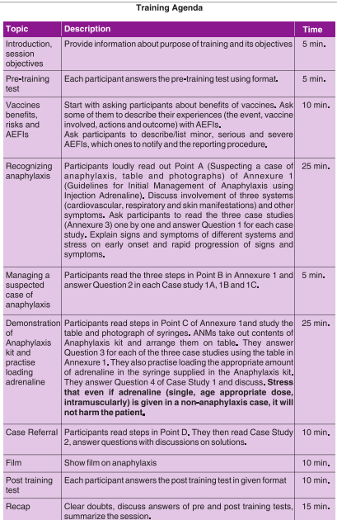
Training of Health workers
A dedicated 2 hour training of ANMs/HWs to enable ANM to identify signs of anaphylaxis and use age appropriate dose of adrenaline for initial management.
25-30 ANMs per training batch
Translate training material (job aid, pre and post training test, case studies) into vernacular language.
Ensure availability of
Anaphylaxis kit – one per participant
laptop with projector and speakers for showing training film

Slide 14
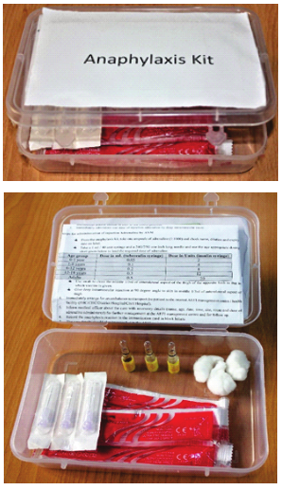
Post training activities
Catch up trainings for any untrained ANMs
Regular monitoring of availability of anaphylaxis kit with ANM and its certification by Medical officer.
Include availability of anaphylaxis kit (with adrenaline within expiry date) at session site in monitoring of RI sessions
Reporting of anaphylaxis case following vaccination as a severe/serious AEFI by sharing the Case Reporting Form (CRF)
Regular reorientation of health workers during monthly meetings

Slide 15
Summary
Anaphylaxis kit should be available at all immunization sessions
Adrenaline has short expiry (usually 12-18 months from the month of manufacturing)
The kit is to be duly certified by the medical officer for expiry of inj. Adrenaline every three months.
Anaphylaxis kit should contain age appropriate dosage chart along with job aid for the ANM translated in local language.
Insulin/tuberculin syringes supplied should be without fixed needles.
One inch long 24/25G needle should be used to administer single age appropriate dose by the ANM.

Slide 16
THANK YOU

